Slide 1
Neuroinformatics 1: review of statistics
Kenneth D. Harris
UCL, 28/1/15

Slide 2
Types of data analysis
Exploratory analysis
Graphical
Interactive
Aimed at formulating hypotheses
No rules – whatever helps you find a hypothesis
Confirmatory analysis
For testing hypotheses once they have been formulated
Several frameworks for testing hypotheses
Rules need to be followed
In principle, you should collect a new data set for confirmatory analysis
(For drug trials, this really matters. For basic research, people usually don’t bother).

Slide 3
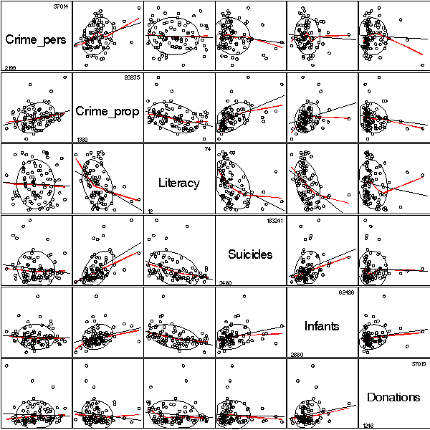
Exploratory analysis
In low dimensions:
Histograms
Scatterplots
Bar charts
In high dimensions:
Scatterplot matrix
Dimensionality reduction (PCA etc)
Cluster analysis
Does NOT confirm a hypothesis
CAN go into a paper – and should, provided you also do confirmatory analysis

Slide 4
Interactive data exploration with gGobi

Slide 5
Confirmatory analysis
We will discuss three types of confirmatory analysis
Classical hypothesis test (p-value)
Model selection with cross-validation
Bayesian inference
Most analyses have a natural “summary plot” to go with them
For correlation, a scatter plot
For ANOVA, a bar chart
Ideally, the summary plot makes the hypothesis test obvious

Slide 6
The “illustrative example”
Show a single example of the phenomenon you are measuring
Pick carefully, because readers will take it far too literally

Slide 7
Building from illustrative example to summary plot
Xue, Atallah, Scanziani, Nature 2014

Slide 8
Classical hypothesis testing
Null hypothesis
What you are trying to disprove
Test statistic
A number you compute from the data
Null distribution
The distribution of the test statistic if the null hypothesis is true
p-value
Probability of getting at least the test statistic you saw, if the null hypothesis is true

Slide 9
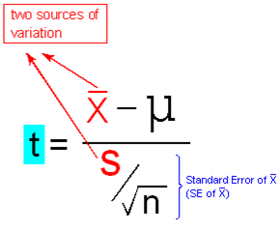
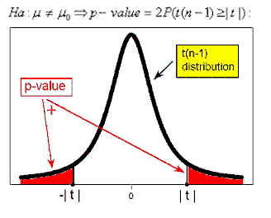
T-test

Slide 10
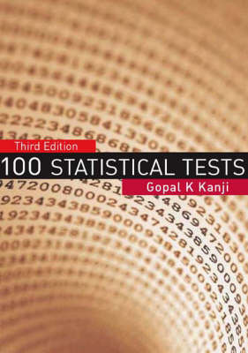
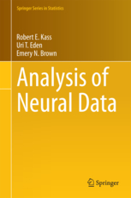

Slide 11
What a p-value is NOT
“I have spent a lot of time with reading figure 4 but I am still not convinced how conclusive the effect is. While I totally buy that the probability of the two variables having zero correlations is P=0.008 … ”
Anonymous reviewer, Nature magazine.

Slide 12
What a hypothesis test is NOT
Failure to disprove a null hypothesis tells you nothing at all. It does not tell you the null hypothesis is true.
Hypothesis tests should not falsely reject the null hypothesis very often (1 time in 20)
They never falsely confirm the null hypothesis, because they never confirm the null hypothesis.
There is nothing magic about the number .05, it is a convention.
Hippocampal pyramidal cells
Hirase et al, PNAS 2001

Slide 13
Assumptions made by hypothesis tests
Many tests have specific assumptions e.g.
Large sample
Gaussian distribution
Check these on a case-by-case basis
This matters most when your p-value is marginal
Nearly all tests make one additional, major assumption
Independent, Identically Distributed samples (IID)
Think carefully whether this holds

Slide 14
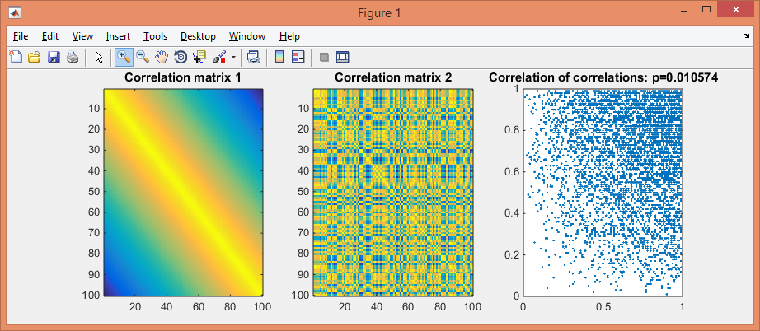
Example: correlation of correlations
IID assumption violated (even excluding diagonal elements)
False positive result for Pearson and Spearman correlation much more than 1 time in 20 (39.4%, 26.2% for chosen parameters).
Exercise: simulate this.

Slide 15
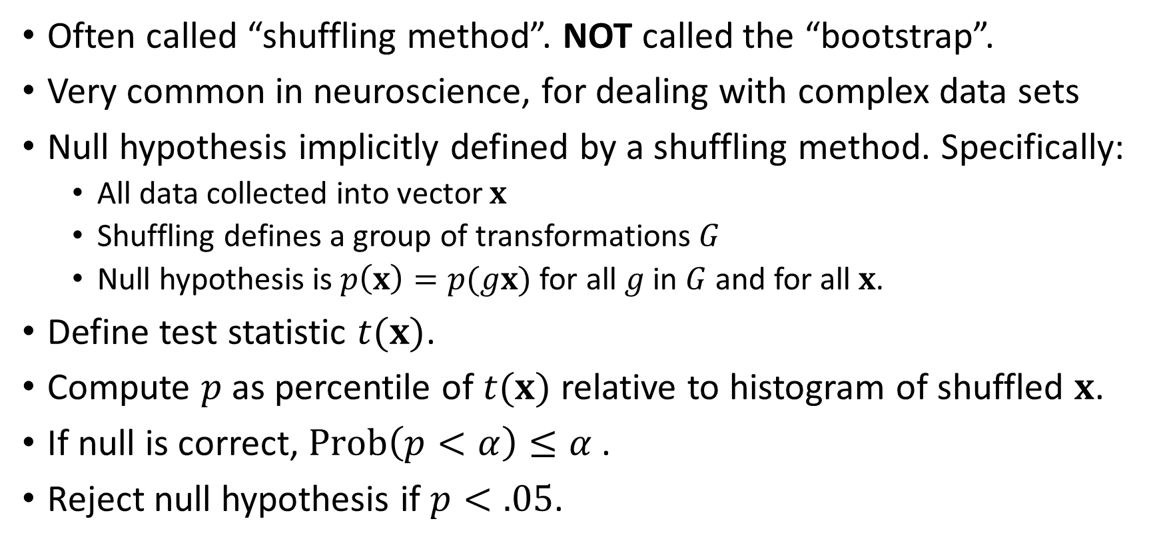
Permutation test
Often called “shuffling method”. NOT called the “bootstrap”.
Very common in neuroscience, for dealing with complex data sets
Null hypothesis implicitly defined by a shuffling method. Specifically:
All data collected into vector $x$
Shuffling defines a group of transformations $G$
Null hypothesis is $p\left(x\right)=p(gx)$ for all $g$ in $G$ and for all $x$.
Define test statistic $t(x)$.
Compute $p$ as percentile of $t(x)$ relative to histogram of shuffled $x$.
If null is correct, $Prob\left(p<α\right)≤α$.
Reject null hypothesis if $p<.05$.
Fisher, “Mathematics of a Lady Tasting Tea”, 1935
Lehmann & Stein, Ann Math Stat 1949
Hoeffding, Ann Math Stat 1952

Slide 16
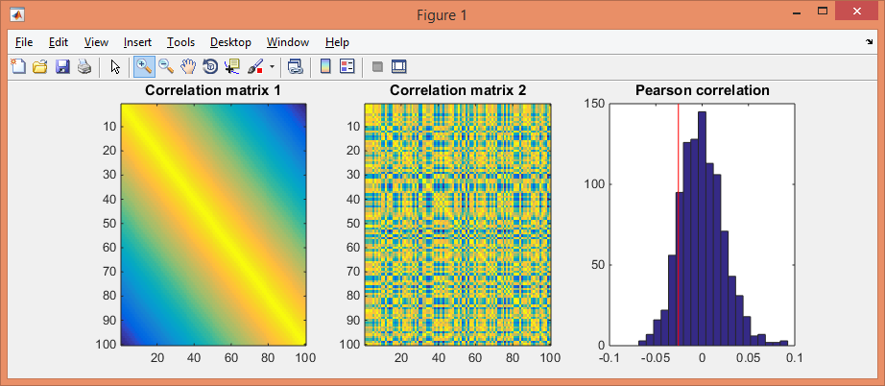
Example: correlation of correlations
Solution: shuffling method randomly permutes variables in second matrix. (p=0.126 in this example)
Test statistic can be Pearson correlation, or whatever you like
We will see lots of ways later to shuffle spike trains etc.

Slide 17
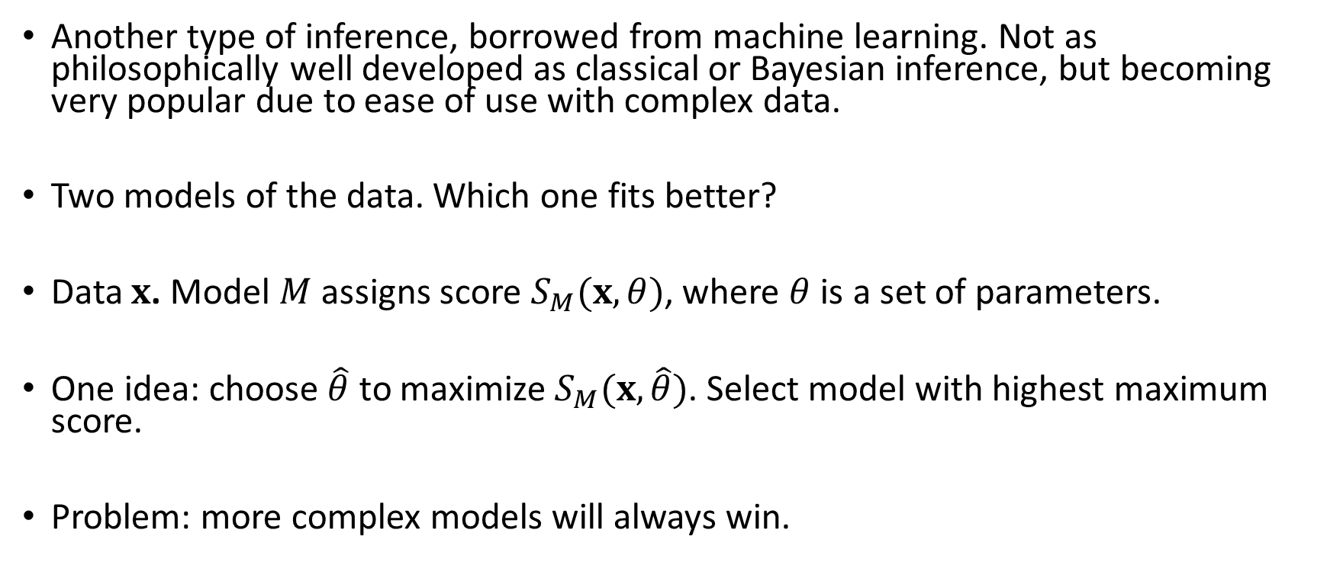
Model selection with cross-validation
Another type of inference, borrowed from machine learning. Not as philosophically well developed as classical or Bayesian inference, but becoming very popular due to ease of use with complex data.
Two models of the data. Which one fits better?
Data $x$. Model $M$ assigns score $S_{M}(x,θ)$, where $θ$ is a set of parameters.
One idea: choose $\hat{θ}$ to maximize $S_{M}(x,\hat{θ})$. Select model with highest maximum score.
Problem: more complex models will always win.

Slide 18
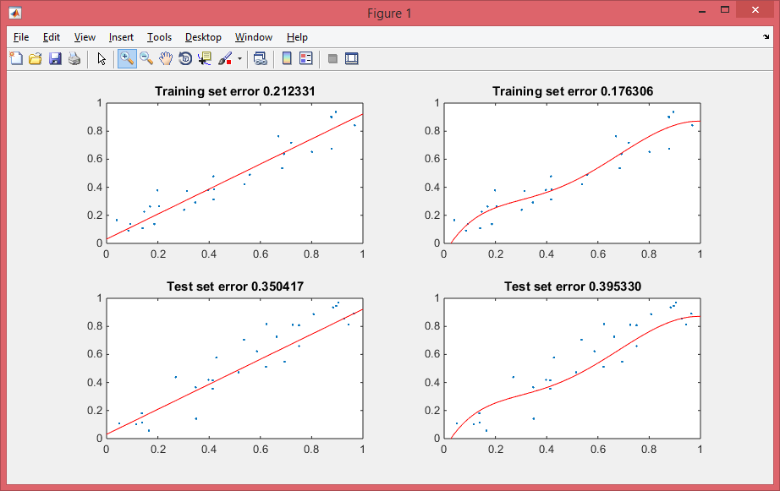
Example: curve fitting by least squares
Which model fits better: a straight line or a curve?
Curve appears to win!

Slide 19
Test both models on new validation set
Now curve does worse

Slide 20
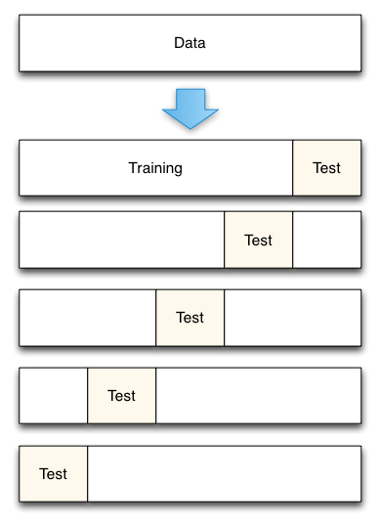
Cross-validation
Repeatedly divide data into training and test sets
Fit both models each time, measure fit on test set
See which one wins
If curve fits better than line, infer that relationship is not actually linear.
Formal theory of inference using cross-validation not yet developed (as far as I know)

Slide 21
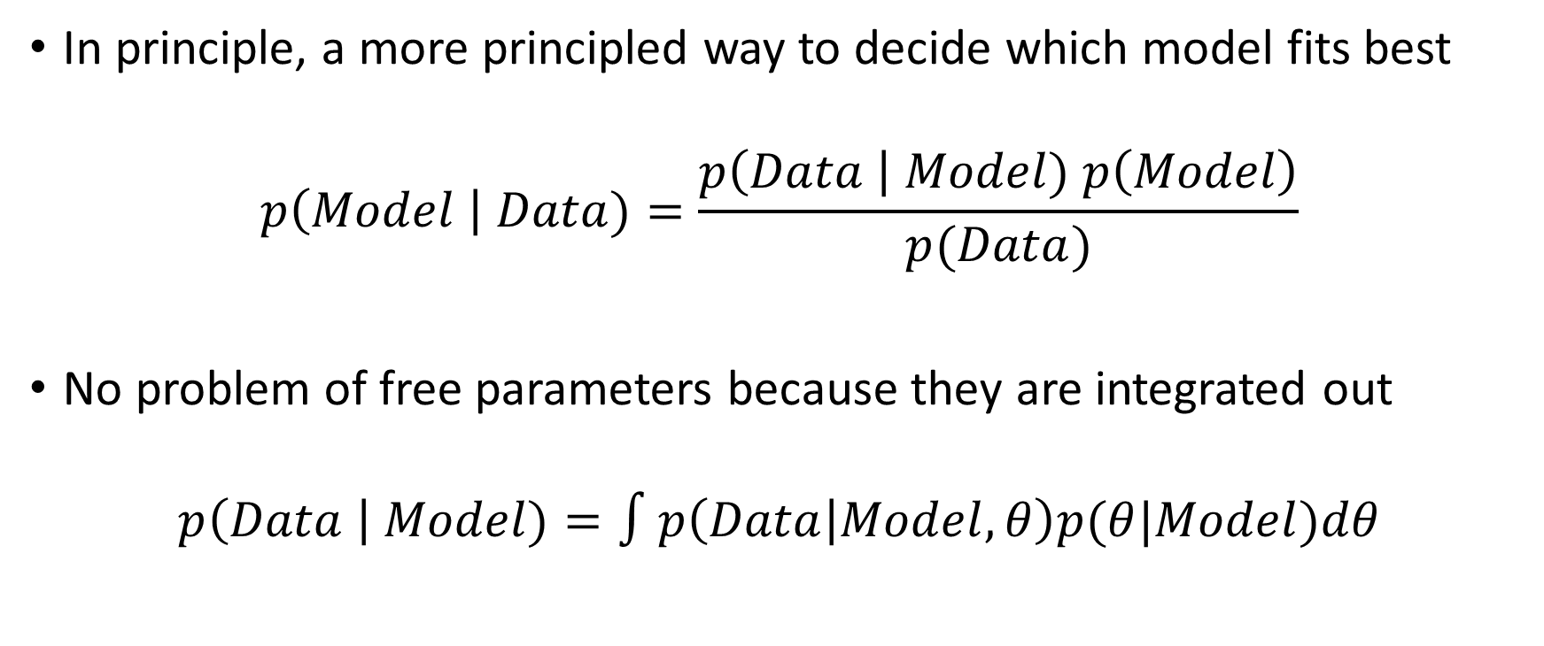
Bayesian Inference
In principle, a more principled way to decide which model fits best
$$p\left(Model \right| Data)=\frac{p\left(Data \right| Model) p\left(Model\right)}{p(Data)}$$
No problem of free parameters because they are integrated out
$$p\left(Data \right| Model)=∫p\left(Data | Model, θ\right)p(θ|Model)dθ$$

Slide 22
Bayesian Inference
Advantages
Well-developed philosophical and theoretical framework
Optimal inference when models are correct
Some statisticians really, really like it
Allows one to accept as well as reject hypotheses
Disadvantages
Math can be intractable, requiring long computational approximations
Requires defining prior probabilities – sometimes you have no idea
Incorrect inferences if models are wrong
Unfamiliar to many experimental scientists/reviewers

